Slide 1
My Perimeter, Area and Volume Interactive Notebook
Name
Class
Term 3 Semester 2

Slide 2
Contents
Formula Page
Page
Date
Description
2
3

Slide 3
Tasks
24
7
30
Essential Question
Questions
Notes
Summary
10
11

Slide 4
24
7
30
Date
Volume
EQ – How do I calculate the volume of a rectangular prism?
What is volume?
The amount of space taken up by the solid.
11

Slide 5
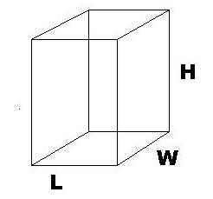
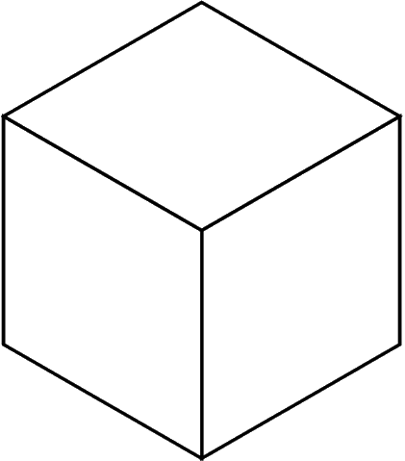
Task
How many small cubes fit inside the rectangular prism?

Slide 6
24
7
30
Date
Volume
EQ – How do I calculate the volume of a rectangular prism?
What is volume?
The amount of space taken up by the solid.
A rectangular prism
11

Slide 7
24
7
30
Date
Volume
EQ – How do I calculate the volume of a rectangular prism?
What is volume?
The amount of space taken up by the solid.
How do I find the volume of a rectangular prism?
A rectangular prism
Volume = length x width x height
11

Slide 8
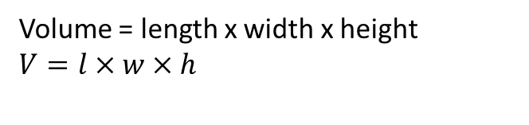
24
7
30
Date
Volume
EQ – How do I calculate the volume of a rectangular prism?
What is volume?
The amount of space taken up by the solid.
How do I find the volume of a rectangular prism?
A rectangular prism
Volume = length x width x height
$$V=l×w×h$$
11

Slide 9
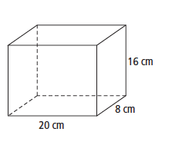
24
7
30
Date
Volume
EQ – How do I calculate the volume of a rectangular prism?
What is volume?
The amount of space taken up by the solid.
How do I find the volume of a rectangular prism?
A rectangular prism
Volume = length x width x height
$$V=l×w×h$$
Example – Find the volume of the rectangular prism.
11

Slide 10
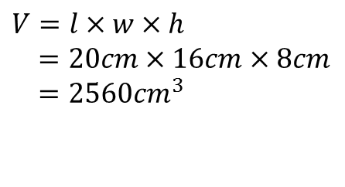
24
7
30
Date
Volume
EQ – How do I calculate the volume of a rectangular prism?
What is volume?
The amount of space taken up by the solid.
How do I find the volume of a rectangular prism?
A rectangular prism
Volume = length x width x height
$$V=l×w×h$$
Example – Find the volume of the rectangular prism.
$$V=l×w×h$$
$=20cm×16cm×8cm$
$=2560{cm}^{3}$
11

Slide 11
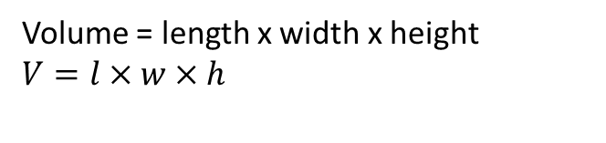
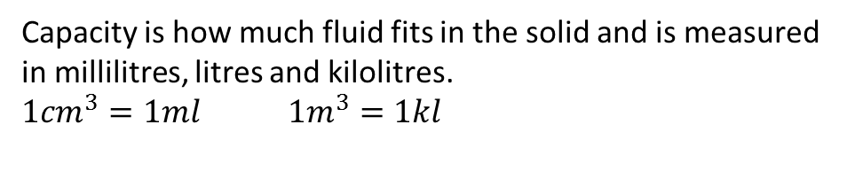
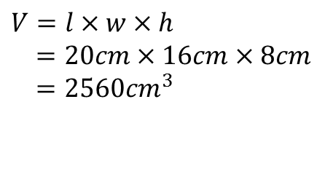
24
7
30
Date
Volume
EQ – How do I calculate the volume of a rectangular prism?
What is volume?
The amount of space taken up by the solid.
A rectangular prism
How do I find the volume of a rectangular prism?
What is capacity?
Volume = length x width x height
$$V=l×w×h$$
Example – Find the volume of the rectangular prism.
$$V=l×w×h$$
$=20cm×16cm×8cm$
$=2560{cm}^{3}$
Capacity is how much fluid fits in the solid and is measured in millilitres, litres and kilolitres.
$1{cm}^{3}=1ml$ $1m^{3}=1kl$
11

Slide 12
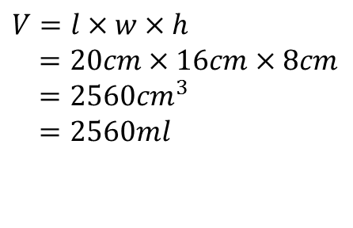
24
7
30
Date
Volume
EQ – How do I calculate the volume of a rectangular prism?
What is volume?
The amount of space taken up by the solid.
A rectangular prism
How do I find the volume of a rectangular prism?
What is capacity?
Volume = length x width x height
$$V=l×w×h$$
Example – Find the volume of the rectangular prism.
$$V=l×w×h$$
$=20cm×16cm×8cm$
$=2560{cm}^{3}$
$=2560ml$
Capacity is how much fluid fits in the solid and is measured in millilitres, litres and kilolitres.
$1{cm}^{3}=1ml$ $1m^{3}=1kl$
11

Slide 13
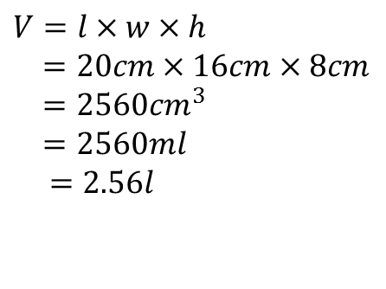
24
7
30
Date
Volume
EQ – How do I calculate the volume of a rectangular prism?
What is volume?
The amount of space taken up by the solid.
A rectangular prism
How do I find the volume of a rectangular prism?
What is capacity?
Volume = length x width x height
$$V=l×w×h$$
Example – Find the volume of the rectangular prism.
$$V=l×w×h$$
$=20cm×16cm×8cm$
$=2560{cm}^{3}$
$=2560ml$
$$=2.56l$$
Capacity is how much fluid fits in the solid and is measured in millilitres, litres and kilolitres.
$1{cm}^{3}=1ml$ $1m^{3}=1kl$
11

Slide 14
Notes Review
24, 7 ,30
Date
Title
Essential question
Notes complete
Notes complete with colour and diagrams
Questions completed
Contents page filed in
Formula page filled in

Slide 15
Homework
Review your notes and write a summary answering the essential question.

